Slide 1


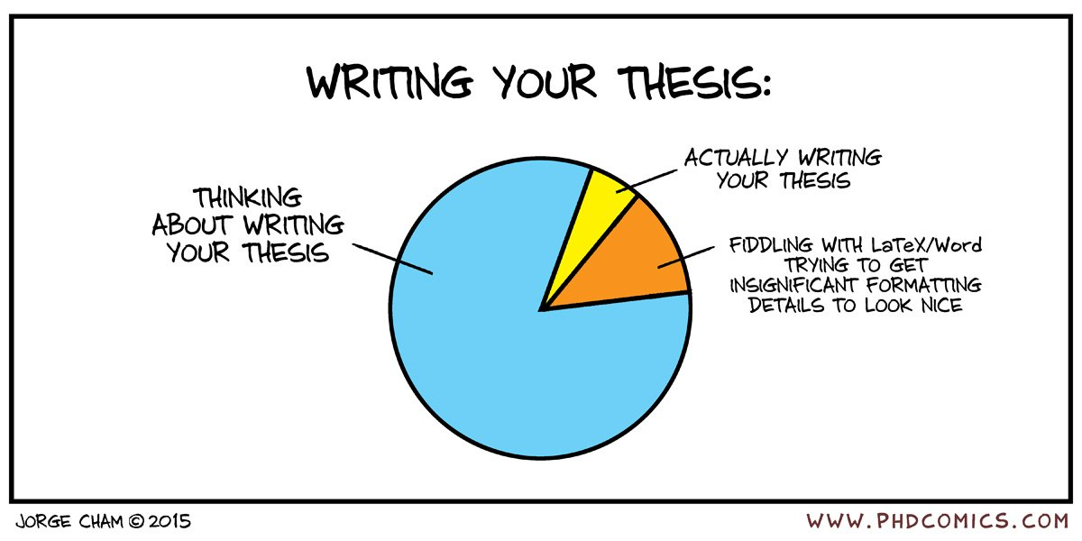

Introduction to CASA Dissertations
Module convenor: Dr Andy MacLachlan
Dr Marin De Jode
January 2021

Slide 2
Leaning outcomes for the module
Formulate an original and novel research question applicable to the discipline of spatial analysis.
Describe, explain and synthesize literature and policy documents relevant to the research question and objectives.
Develop a robust research design demonstrating technical proficiency and advanced skills.
Describe and explain results with a clear and guiding narrative.
Critically reflect on findings and discuss the academic and or policy advancements from the research.
Construct and manage a substantial independent research project.

Slide 3
Learning Objectives, by the end of the session you should be able to:
Explain what an MSc dissertation is and how it differs to a normal module and assignment
Describe the process for completing an awesome dissertation at CASA.
Identify where to find supporting material to aid development of your dissertation
Select tools and techniques for commencing an MSc thesis

Slide 4
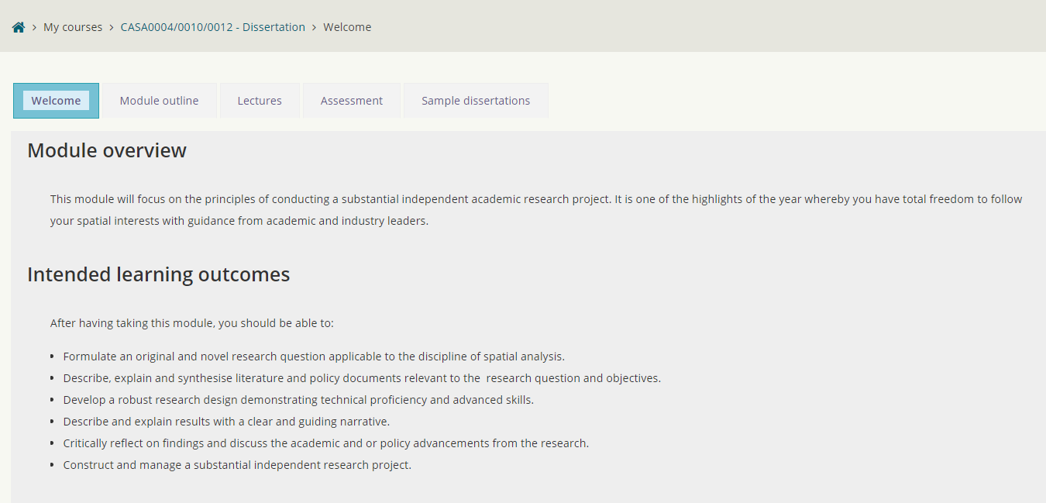
Moodle
There is only one Moodle page for everyone
MRes, SCUA and SDSV
MRes have two submissions on the assessment tab

Slide 5
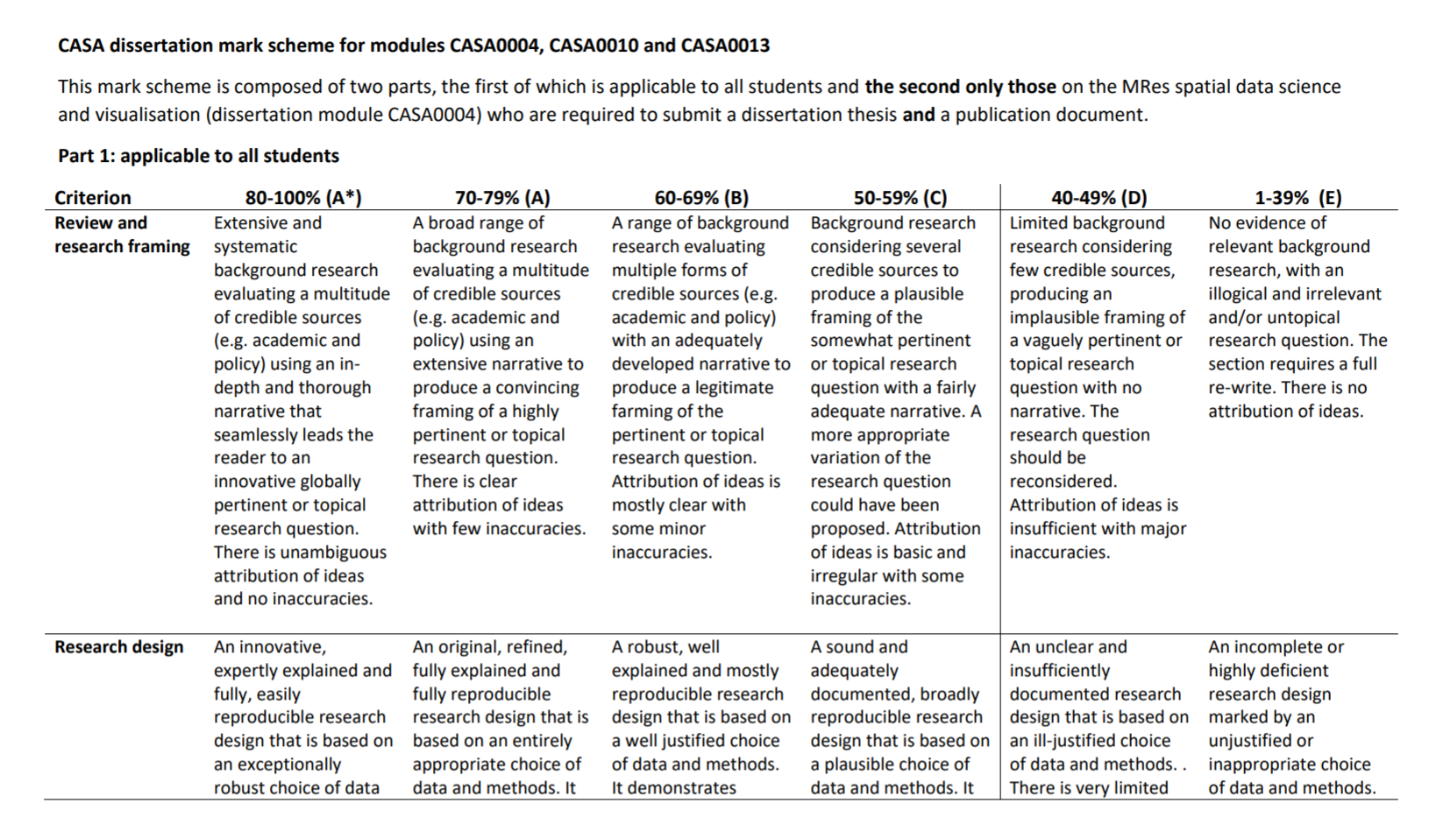
Mark scheme

Slide 6
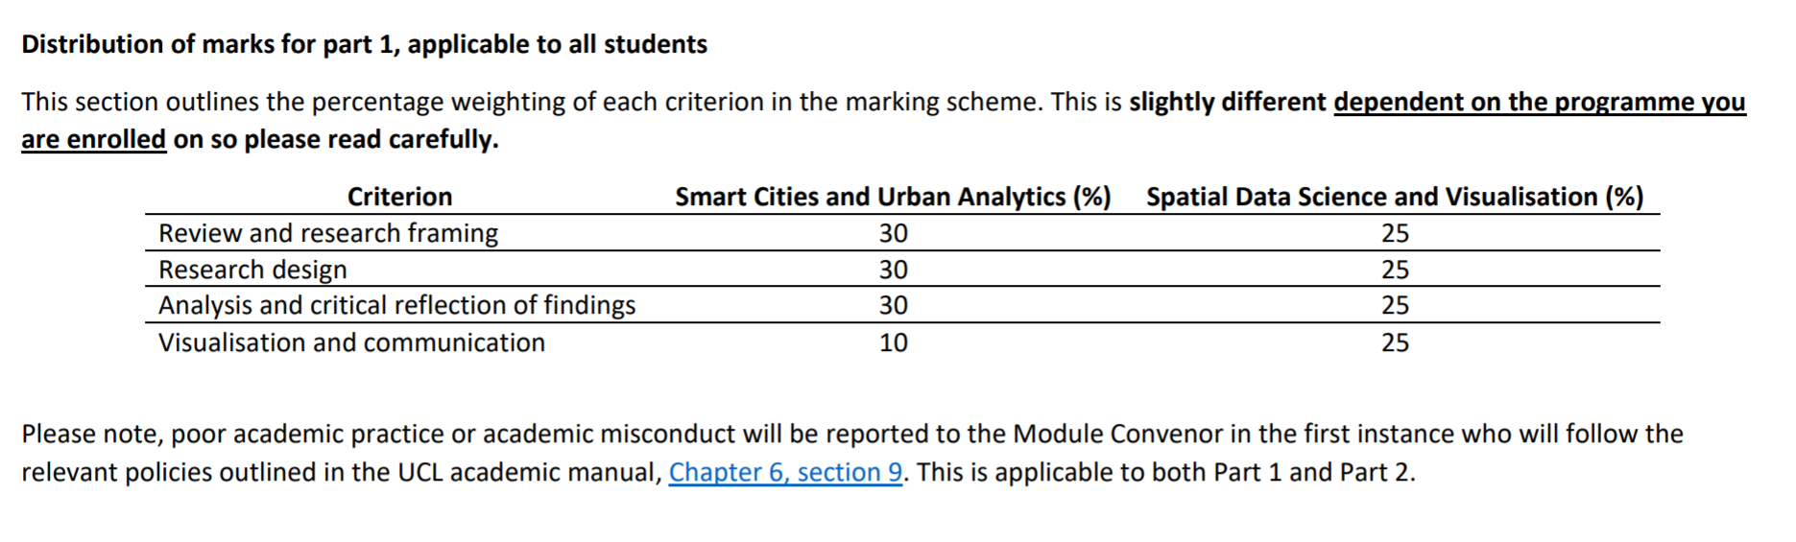
Mark scheme division of marks by programme
For those on CASA0010 (smart cities) and CASA0012 (spatial data science)
Thesis is worth 100% of the grade
For those on CASA0004:
Main thesis is worth 70%
Publication is worth 30%

Slide 7
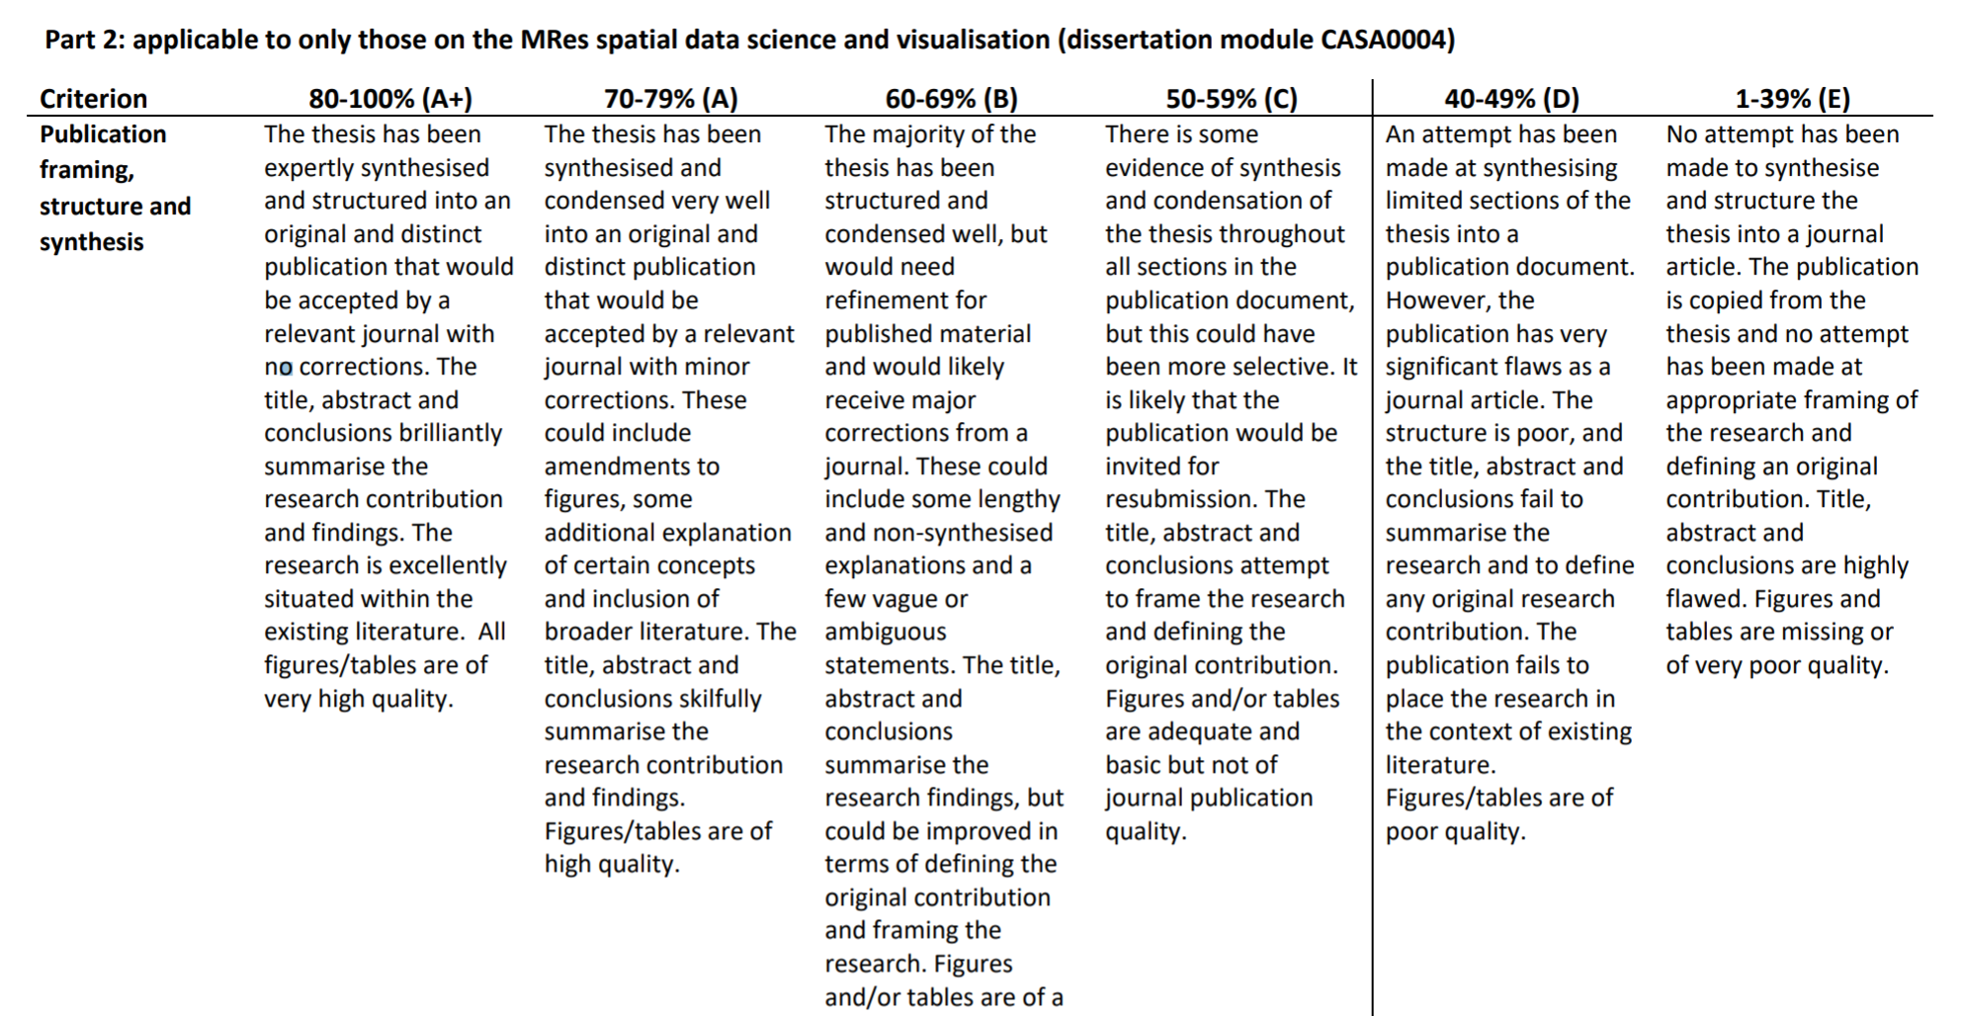
MRes publication mark scheme

Slide 8
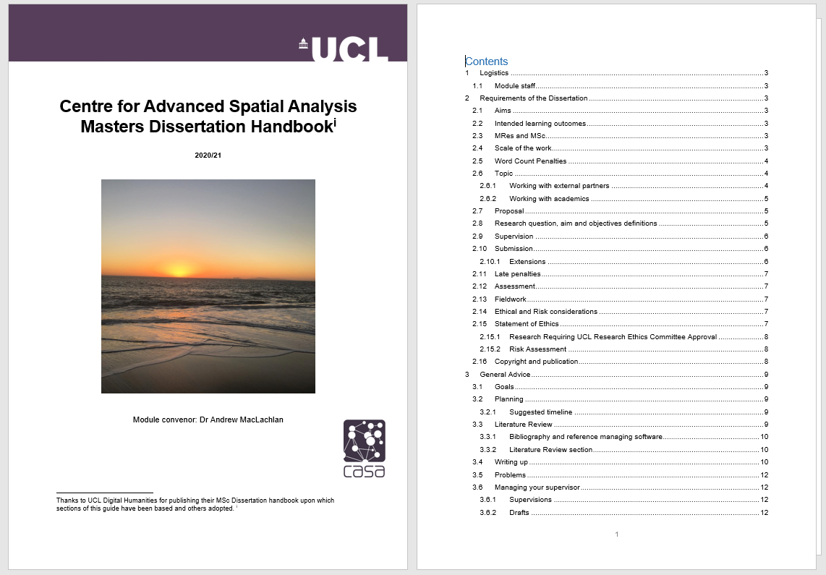
Almost everything you need to know about writing and submitting your dissertation is in the CASA dissertation handbook – please consult this first if you have any questions of queries

Slide 9
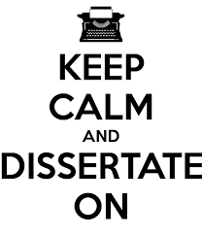
What is a dissertation?
Not just an essay / report
You work on an **original** and extended research project independently and produce a 10,000 word thesis
You will have a supervisor who will guide you through the process, suggest data and analysis, review your work
You can propose your own topic or apply for one advertised by several CASA partners or the CDRC
Students have succeeded at both, just because you apply for a project doesn’t guarantee success.

Slide 10
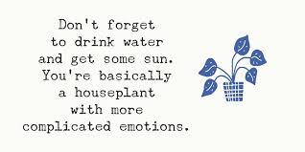
What is a dissertation?
60 credits (MSc) or 90 credits (MRes) of 180 Credit degree
60 credits = 600 hours, 90 credits = 900 hours
Around 18 weeks from term 3 (26/4)
33 hours/ week MSc
50 hours/week MRes
But you start in term 2 so less than this.
Basically 9-5 job

Slide 11

What is original research
Let’s go back in time to the ‘how to succeed in your degree talk’ from the start of the year….

Slide 12
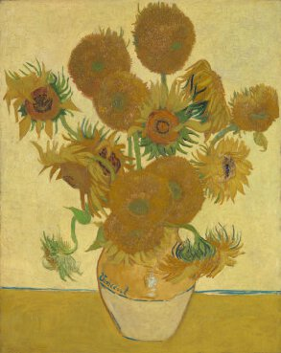

Writing Problem 5 – insight, originality and coherence
Original?

Slide 13
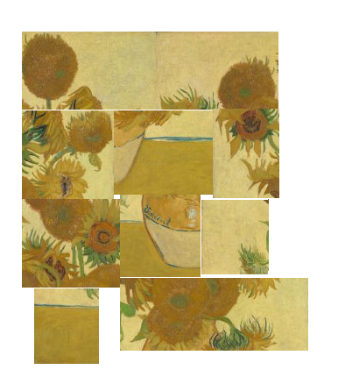
Writing Problem 5 – insight, originality and coherence
Coherent?

Slide 14
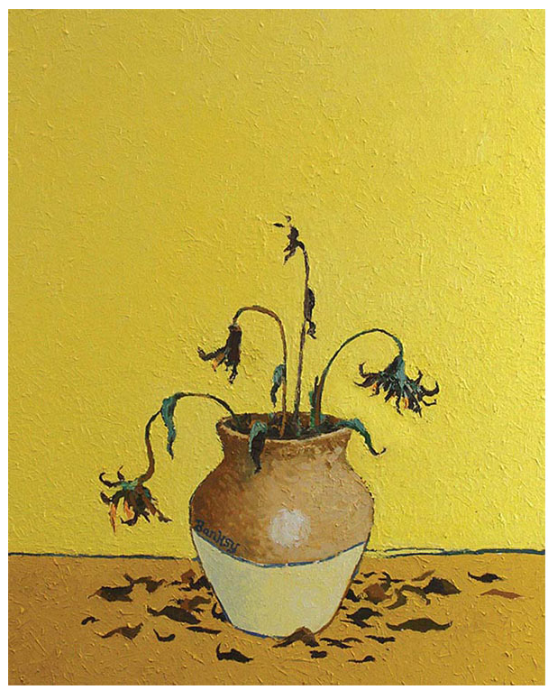
Writing Problem 5 – insight, originality and coherence
Insightful…?

Slide 15
Writing Problem 5 – insight, originality and coherence
Original: You need to write the assignment in your own words that tells a narrative through the existing research. Don’t just state what others have done
present or existing from the beginning; first or earliest
Coherent: Make your points in a logical manner, with support from literature (or policy documents). Don’t just assume the reader knows what you are talking about because they are an academic. Build the story, don’t just jump to the ending.
logical and consistent
Insightful: Clearly showing that you understand the methods, concepts and debates discussed but also how your analysis (or discussion) did or could add meaning in some way.
having or showing an accurate and deep understanding; perceptive.

Slide 16
Ccommon research language
Research gap: You need to identify and discuss all the existing work and lead the reader to the gap. What is the gap. What hasn’t been done. Why is that important. MISSING
Contribution: You’ve identified the gap. Be specific throughout your thesis what you are contributing…..As a result this thesis attempts to combine these two datasets for THIS REASON. Continue this through the thesis, especially in the discussion. A POTENTIAL ANSWER
Novel: What is new? Remember this could be a new method, a new study area or a bit of both (or mix too). E.g. use an existing method with a slight variation appropriate for a new study area and some different data as that’s what was available or is free! WHAT IS NEW

Slide 17
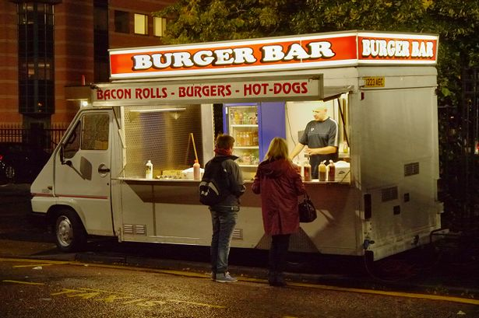
What are you selling – be specific

Slide 18
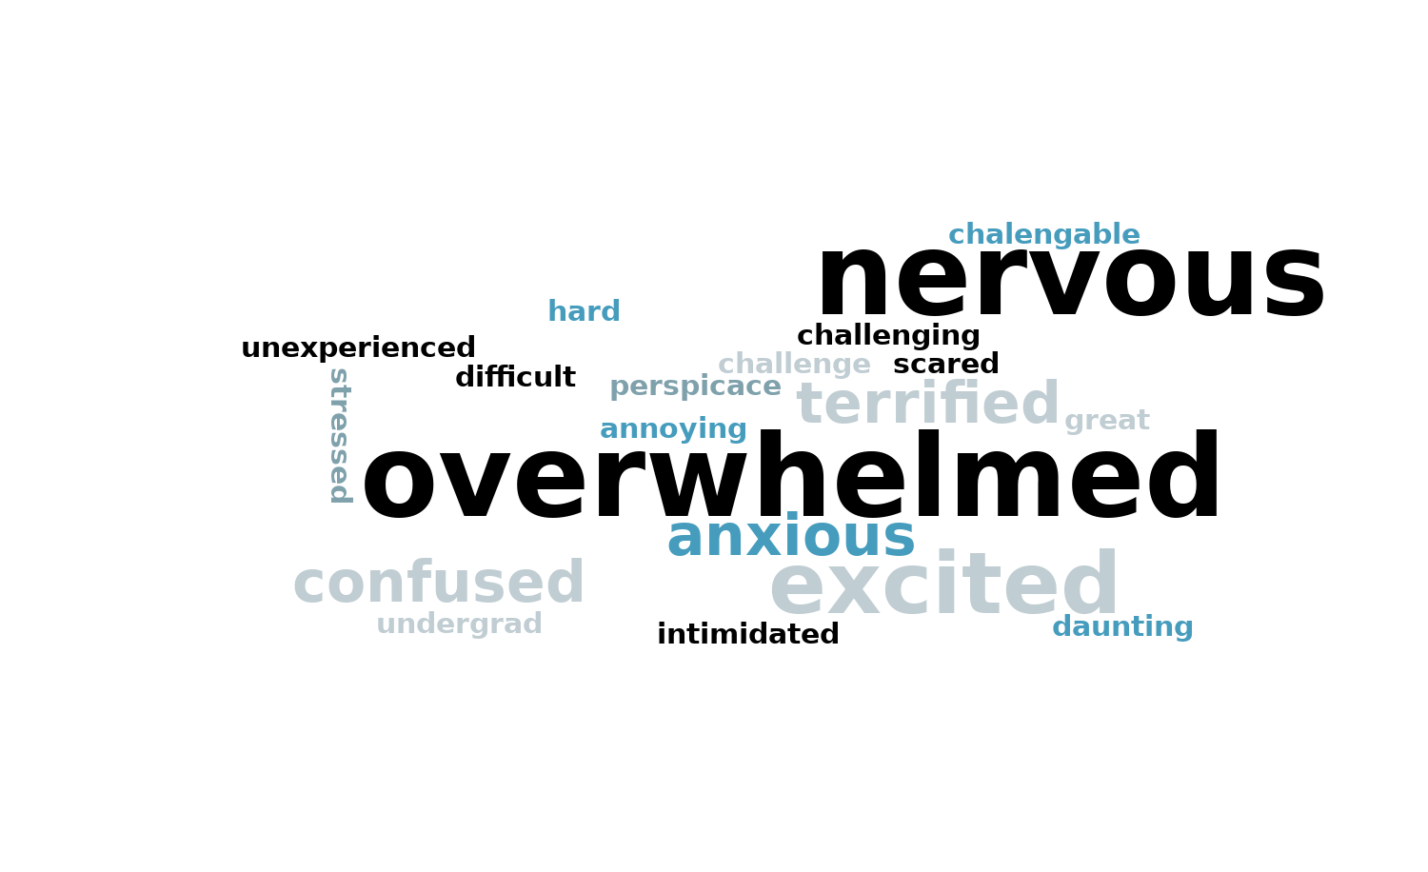
How do you feel about writing a 10,000 word MSc or MRes thesis
Enter Text and Press Send
Join: vevox.app ID: 186-395-009
Vote Trigger

Slide 19


Where do I even start? I can’t possibly write 10,000 words
Everyone feels like this. Here are some tactics / tools that I have used:
Look for debate / contestation / arguments in literature / policy. Policy is great as it’s nearly always behind academic literature / methods / approaches.
Watch the video from 0:15 to 1:19
They debate policies, you debate ideas, concepts, literature and polices.
Debate sparks interest.

Slide 20
Where do I even start? I can’t possibly write 10,000 words
Everyone feels like this. Here are some tactics / tools that I have used:
Start with global goals, find what interests you then see how it’s being implemented locally.
Original research is usually (a) an existing method applied to a new (different) area or (b) a new method for an existing problem.
Read widely – look for methods that have been applied elsewhere / in a non-spatial manner.
Break it down into manageable sections. It’s not 10,000 words. It’s a 1,000 word introduction, a 2 -3,000 word literature review, 1,000 word methodology, 1,000 word results, 3,000 word discussion, 2,000 word conclusion.

Slide 21
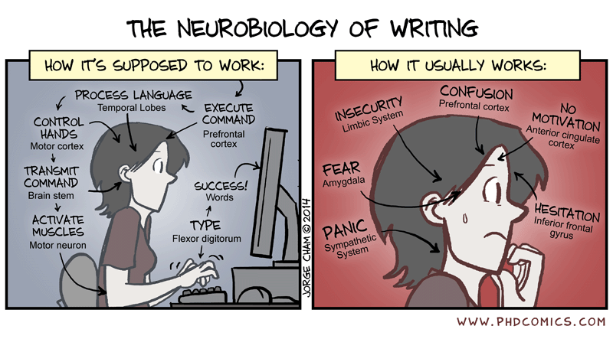
Where do I even start? I can’t possibly write 10,000 words
Everyone feels like this. Here are some tactics / tools that I have used:
Can I have the data now please?
Be guided by the data – no data then it’s a ‘no go’
What are you contributing, so what?
Are you actually interested in this?
Set up your document from the start
Send your supervisor work before the meeting.

Slide 22
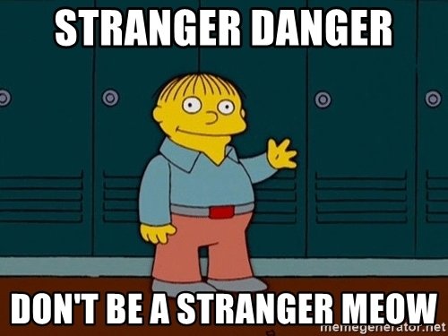
TL;DR
Two best pieces of advice
Write something
Anything
It will be awful
You will improve it
Share it with you supervisor
Don’t be afraid of the ‘red’ pen
Not sharing is when problems happen
I can guarantee you all academics have had some work torn apart. Ask your personal tutor.
Force yourself to write 100 (ish) words a day for 100 days
If something isn’t working after several hours…STOP…sleep on it, come back fresh

Slide 23
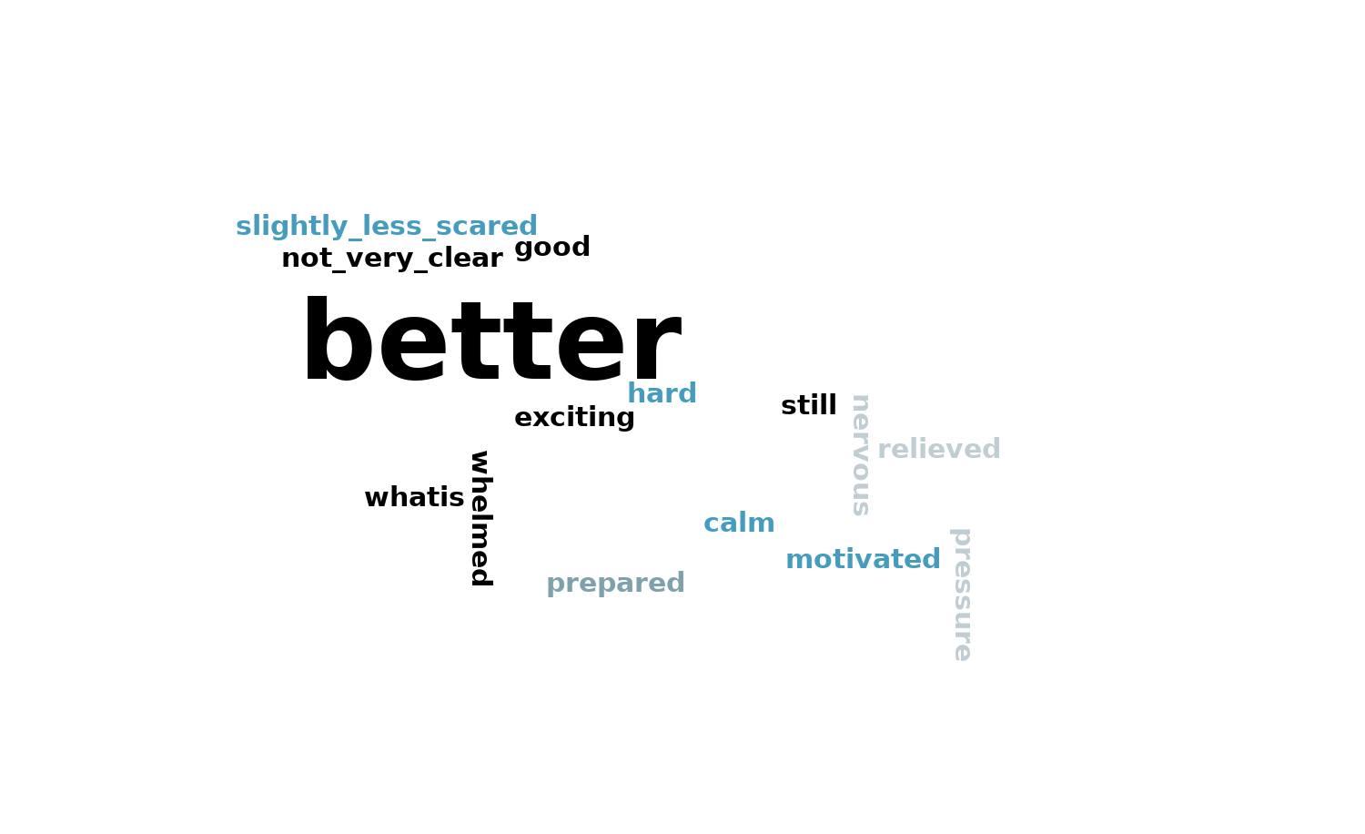
How do you feel now
Join: vevox.app ID: 186-395-009
Enter Text and Press Send
Vote Trigger

Slide 24
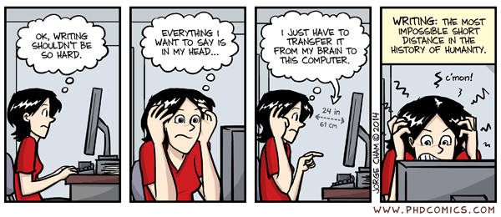
Difference between an MRes and an MSc Dissertation
MRes (10,000 words, 70%), plus research paper (5,000 words 30%): original piece of research with more sophisticated methods. Aim to have it published.
MSc (~10-12,000 words): Original dissertation on a specific topic that could lead to publication or could be the starting point for further research for later publication.

Slide 25
Ethical and risk considerations
All dissertations require a Statement of Ethics summarising any ethical issues around the research, and steps taken to protect subjects and/or their data. If your research does not require ethical approval or data protection, you still need to state the reasons why and show reflection of potential issues.
Any research at UCL that makes use of living human participants, or the collection and/or study of data derived from living human participants requires approval from the UCL Research Ethics Committee or the National Research Ethics Service, unless it falls into one of their exemption categories.
If you are planning to record information that would allow your research subjects to be identified, then you will need to inform the UCL Data Protection Officer of your plans.

Slide 26
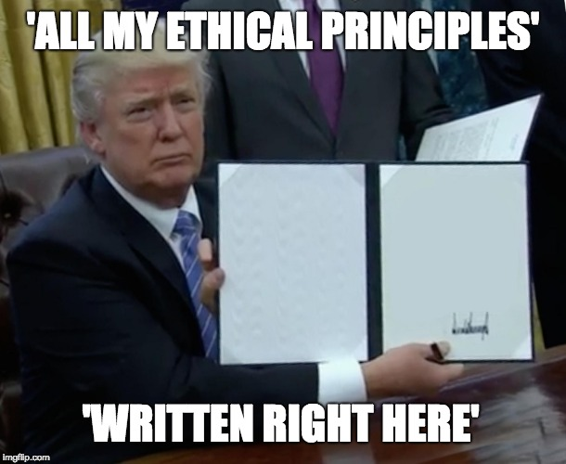
Ethical and risk considerations

Slide 27
Citing and plagiarism
Be careful. Properly cite the material you have been using for your work,
“Any quotation from the published or unpublished works of other persons must, therefore, be clearly identified as such by being placed inside quotation marks…”
Changing the words of an original source is not sufficient to prevent plagiarism. If you have retained the essential idea of an original source, and have not cited it, then no matter how drastically you may have altered its context or presentation, you have still plagiarized…
Self-plagiarism (submitting work you have already submitted for assessment)

Slide 28
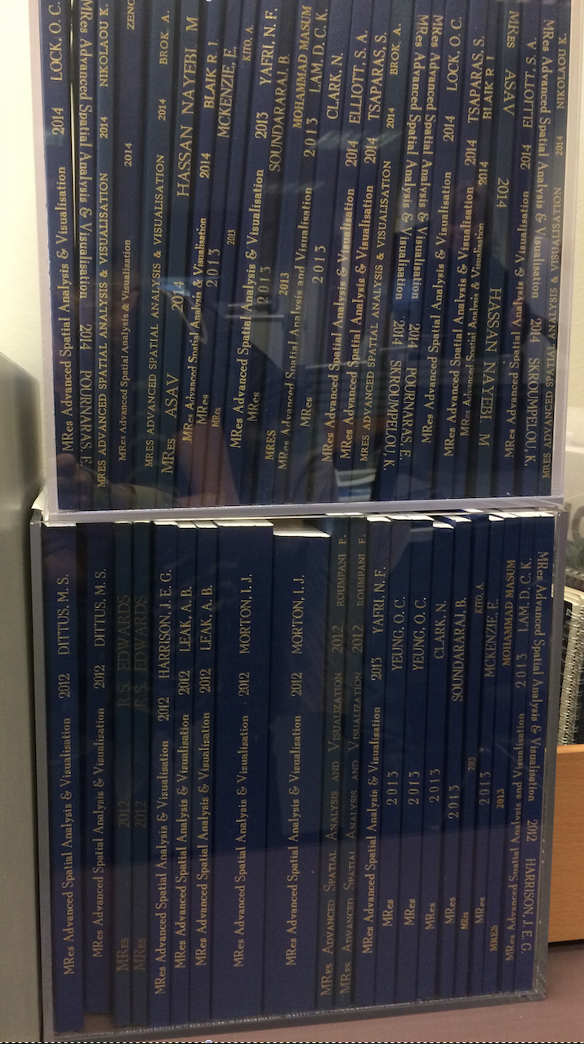
Project ideas / challenges
Your own
Industry (CDRC, Westminster etc.)
CASA / lecture material
Literature
Blogs / websites
Policy documents

Slide 29

Application process launches 21/01/18
www.cdrc.ac.uk/retail-masters/
The programme gives students the opportunity undertake their dissertation which solves a problem set by a large company
Students entered into competition to win cash prizes (£500, £250, £250) funded by the CDRC.
Students are also offered a £500 bursary upon successful project completion
Research can take place on site with the industry sponsor + supervisor from CASA
Students and supervisors will be invited to an academic conference in October

Slide 30




























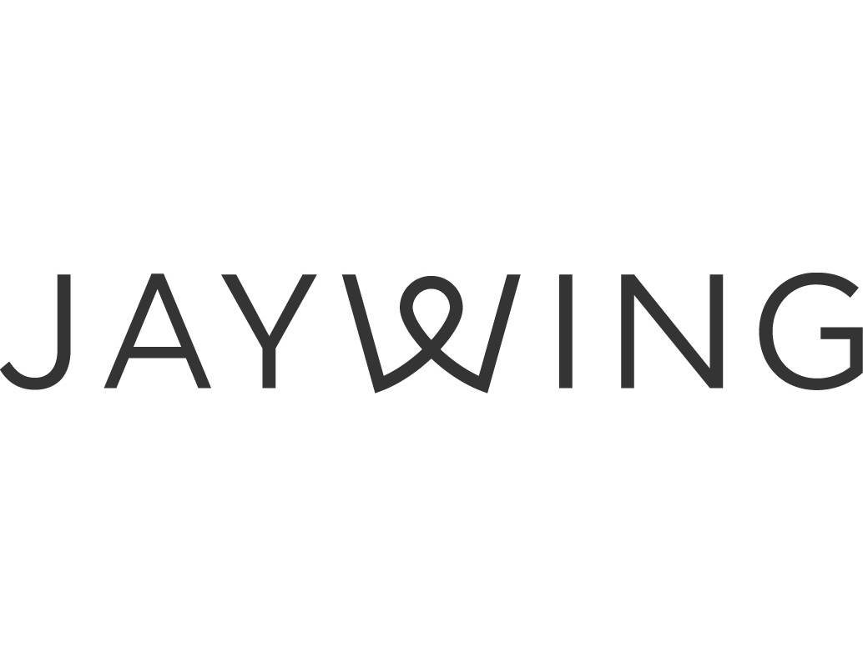


Sponsors

Slide 31
Timeline
January
Projects are advertised on the CDRC website
Jan - Apr
The student application process is open. The CDRC will forward selected CVs and cover letters.
May - Aug
Research is undertaken either at the students own institution or on-site with the industry sponsor
September
Dissertations are submitted to the CDRC and industrial sponsors
October
Participants are invited to an Academic conference where the prizes are awarded
Notes:
Previous projects have included:
Census analysis
Time-series analysis
Social media data
Customer Segmentation
Spatial interaction modelling
Topic Modelling

Slide 32
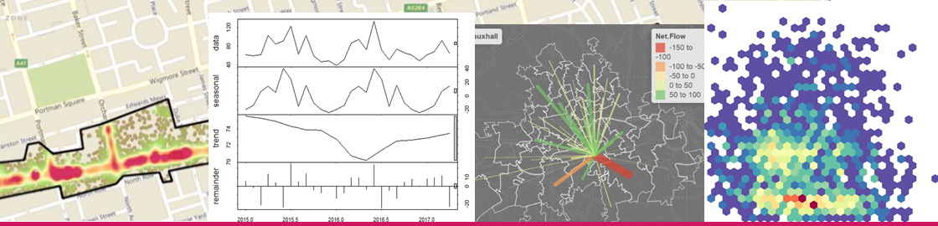
The programme offers students a unique opportunity to apply their skills to real-world problems and to gain valuable experience working with commercial datasets
https://www.cdrc.ac.uk/retail-masters/archive/ featuring CASA Alumni, Neelam Kundi, Kahina Ait Ouazzou, Christopher Storey, Davina Tijani, Paula White and Runsang Yu
Panel images from left to right: Christian Tonge (2017), Paula White (2017), Neelam Kundi (2017), Ulzhan Bissarinova (2017)
Notes:
A unique opportunity to work with an industrial partner
First hand research experience in applied problem-solving
(Often) an exclusive opportunity to work with commercial data
Excellent exposure to the academic and industry data analytics communities
A valuable addition to your CV

Slide 33

CASA / WCC, Reflections
Highly value fresh perspectives on opportunities and challenges facing the council
Collaboration offers students opportunity to explore and demonstrate their interests, as well as new skills, whilst benefitting the public
MSc dissertation research affords a rare opportunity for the deep dive research we have limited capacity for
Most importantly: Want to ensure all research projects offer the opportunity to tackle a ‘real world’ problem & tangibly contribute to council’s policies, services and strategy
2020/21: Pre-scoped 3 project briefs based on our knowledge of the data quality, service / policy needs and longevity of council interest in the issue
Some resources which allude to the direction of travel / policy context of the council –especially useful for those who want to propose a topic:
2019-2040 City Plan, was very recently published: https://www.westminster.gov.uk/cityplan2040 , this Arcstory map might be more easily digested
City For All Priorities (shows council objectives, the broader umbrella issues remain fairly consistent year to year)
Westminster’s City and Ward Profile – offers context https://www.westminster.gov.uk/ward-profiles
Notes:
Opportunity for them / us
Continuously improving, welcome your feedback about the experience
What have we learned from previous years, what do we want to offer students & gain from them
Introduce topics / offer
Looks good on your CV / might get you a job!
What we gain from collaborating with CASA students…
Widespread perspective of local government as predominantly operationally focused – and innovation shy & risk averse as all their actions need to be accountable to the public
Accountability includes maximising opportunities to offer excellent and responsive services and policies
Increasing capacity to transform routine data into meaningful information
Big Data Push: how can local authorities leverage data, data they routinely collect to deliver services, as well as utilize emerging and novel data sources limitedly used in evidence based policy making
Through the dissertation & early work at WCC, learning how the BI team figuring out how to get from A to B

Slide 34
Dissertation Process
Dissertation proposals
Interviews for open ended project + others depending on demand
Meeting with WCC coordinators + Logic Model
Information Governance and associated paperwork
Communication – ball’s in your court, but cannot always guarantee prompt responses
Will share a guidance document outline the process in greater detail
Research Dissemination
Your dissertation in full following the deadline
A summary document
Presentation to council staff either at Insight and or meeting with policy / service team
Access and sharing of code on WestminsterBI GitHub (want to contribute to open resources, as well as have opportunity to build on your work – code publication will be fully accredited to you)
Notes:
SITUATING DATA & Topic: Corresponded with policy & city management experts to understand:
The context of and aims to tackle noise complaints
Understand previous work around busking
Understand the details of the data (only tells you what's been asked)

Slide 35
Warning
If you are successful in getting an industry project your dissertation still needs to have some academic merit
Don’t get drawn into just doing a bit of work for the company. The opportunity will vary, but usually they want someone who knows something about spatial data to do a project they can’t do or don’t have time for / it’s just an idea
Questions to consider
What is new with your project
What does it advance
Is it a new applications
Has it been done before
Where is the novelty
Your supervisor will help you with this

Slide 36
You need a Plan B
If you are applying for one of these projects
You can only apply for 1 industry project
At present I’m not 100% sure how many students each will take. If they have asked for multiple projects it usually means they will have several students
You will need a Plan B that doesn’t rely on getting one
I might re-release projects that haven’t been very popular in case you did have a second choice
All projects are open to everyone

Slide 37
Do I need to apply for one
No.
Industry projects don’t always get the top results
If you are interested in something specific then go for it
Last year some of the best projects were developed by students themselves. Look at the examples and you will see!
If you don’t apply for an industry project you won’t need a Plan B

Slide 38
The logistics
Supervisor
You will be assigned a supervisor (member of academic staff within CASA) based on your dissertation proposal
You will also have an industry contact who may want to meet regularly or just leave you to it
Meetings
You can expect 5 meetings with your academic dissertation tutor over the course of the summer – but down to you to organise
Timeline
In the handbook

Slide 39
Late Submissions
No penalty if uploaded before deadline
10% if 1 sec to 2 days late
Capped at pass (50%) if 2-5 days late
Fail (0%) if over a week late
All dissertations will be submitted via Turnitin.

Slide 40
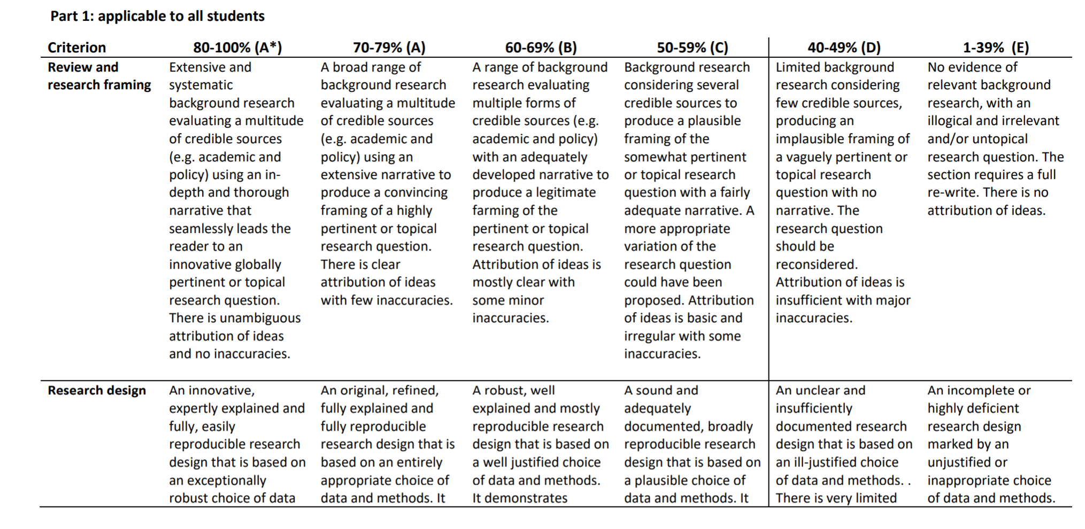
What is a good dissertation?

Slide 41
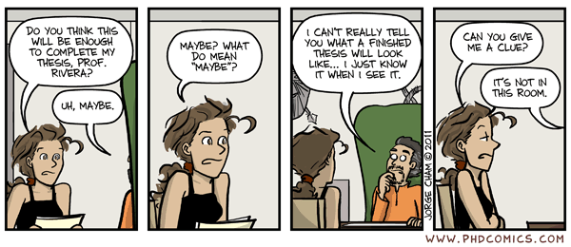
How do I know if mine is any good / is it enough
Common questions / issues:
Is this enough for a thesis
Is my analysis advanced enough
I can’t find any literature on my topic – good (to an extent)
I’m struggling to write a literature review / discussion
I can’t find enough data
I’m just going to compare 4 machine learning methods

Slide 42
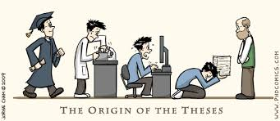
How do I know if mine is any good / is it enough
Common questions / issues:
Don’t expect to just get it right first time
Usually it’s too ambitious or sometimes not enough / needs more though
You will change things and that’s fine
We don’t hold you to your proposal, some students have complete changed topics

Slide 43
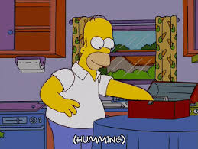
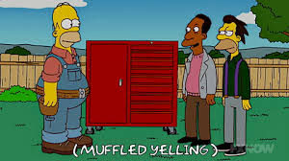
Start with / setup useful tools
What do you know?
GitHub
R
Python
Zotero / Mendeley
Word processor
Data sources
Methods
Trello? – brain dump, to do, doing, waiting, done, CV
We’ll come onto study skills later in the term – weeks 8 and 10.
Set up the basics soon.

Slide 44
MRes Assessment
Dissertation (70%)
10,000-12,000 words
Detailed and complete account of all work with extensive review and discussion
(harder than writing 15,000 words!)
Research Paper (30%)
5,000 words
Succinct account of research suitable for publication in an appropriate journal, following form and format
Journal identified by supervisor and student
Do not just copy directly from your thesis.

Slide 45

MRes Assessment
No attempt has been made to synthesise and structure the thesis into a journal article. The publication is copied from the thesis and no attempt has been made at appropriate framing of the research and defining an original contribution. Title, abstract and conclusions are highly flawed. Figures and tables are missing or of very poor quality.

Slide 46
Hints, Tips and Links
Try to have a work flow in mind; Try to think about and ideally have a rough idea about what you wish to achieve and how? You may need to break it into (more or less) following questions:
what are your input data?
what to do with it or what methodologies and techniques you are going to use? why this and not that technique?
what results you expect to have?
how do you visualise the results?
what are the impacts of your study, what changes could be made? Most students don’t answer this question.
who may use the output and how?

Slide 47
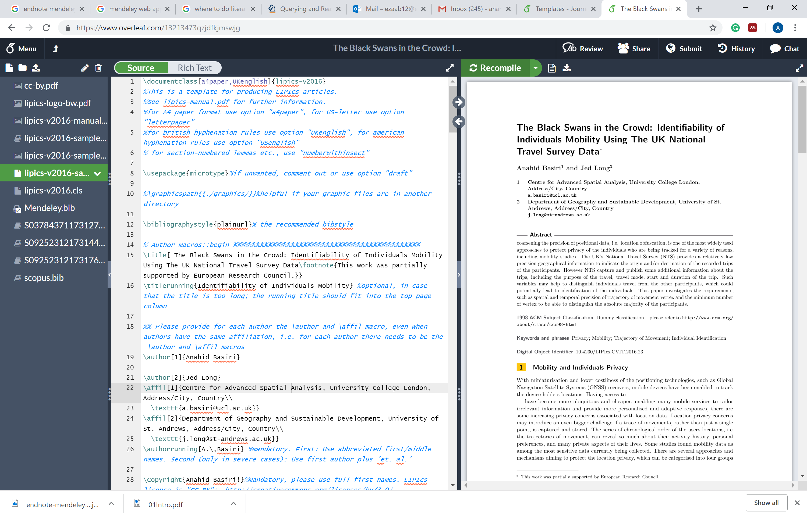
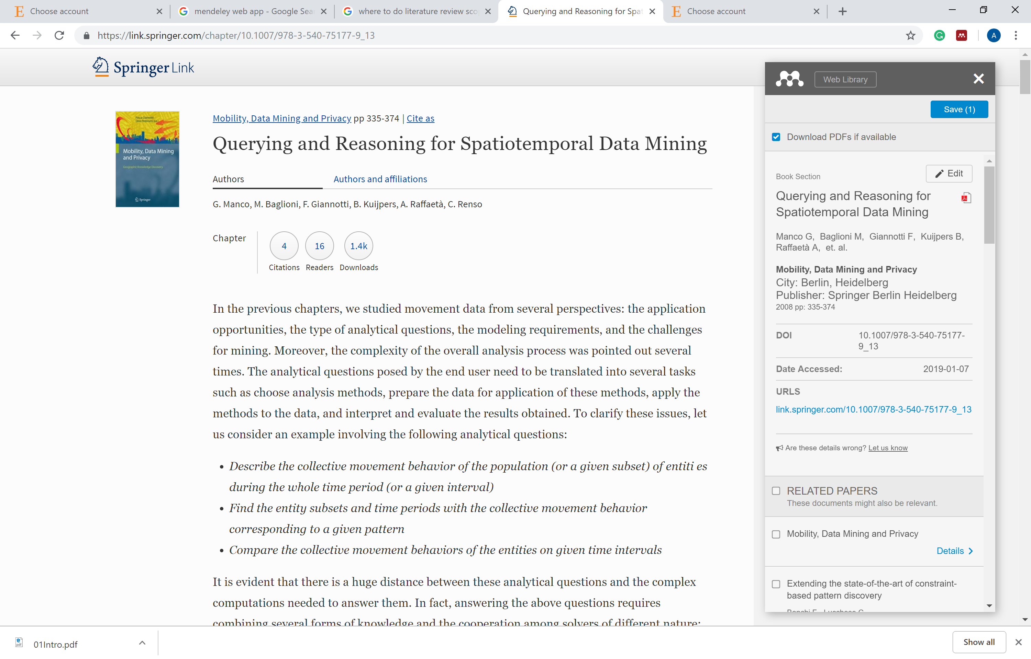
Hints, Tips and Links
Build your references into some sort of data base that you will be using while writing your dissertation: e.g. Mendeley, Zotero, can build Overleaf.
Latex is an option for writing up. It might take you a bit of time to get started, and not very friendly at the beginning but very soon they makes your draft manageable

Slide 48
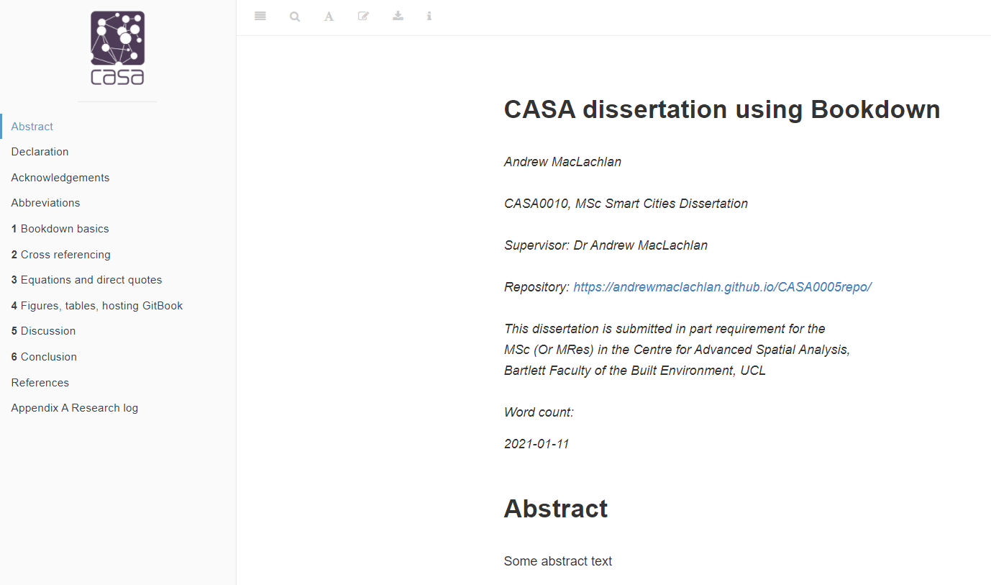
Hints, Tips and Links
In the case of Bookdown you could ask for comments via GitHub.

Slide 49
Publishing
You will be producing an original piece of research that you should aim to publish (in particular MRes students, you will have a research paper which can form a first draft for publication)
Turning your research project (dissertation) into a paper is an art, we will have a separate session on this later in the term with Duncan Smith.
We will have a target special issue for your (first) papers, and we go through the submission to publication process

Slide 50
Prep for next week
Read the Handbook
Read the Mark scheme
Join the Slack channel
Read some of the proposals on Moodle
Think about a project you might be interested in (any project) and do some basic research on it
What data is there?
What has been done before?
What question could I answer?
Is this interesting?
So what?
Is it a go-er?

